Slide 1
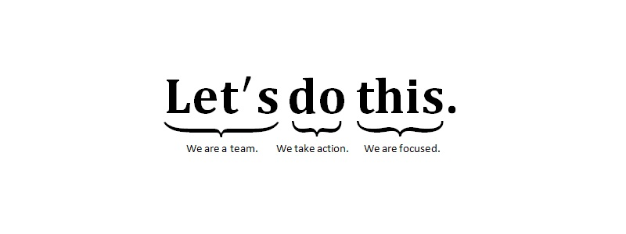


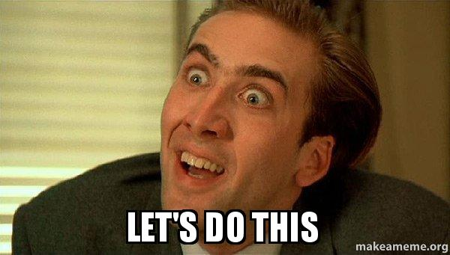

Let’s Make Prototypes!

Slide 2
What is a Prototype?
The prototype is the physical product that represents your ideas—the board and bits.
Great designers do not design great games.
They usually design really bad games, and then they iterate (improve) on them until the games become great.

Slide 3
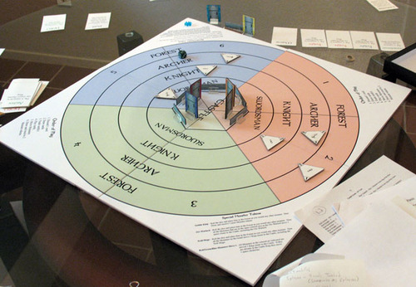
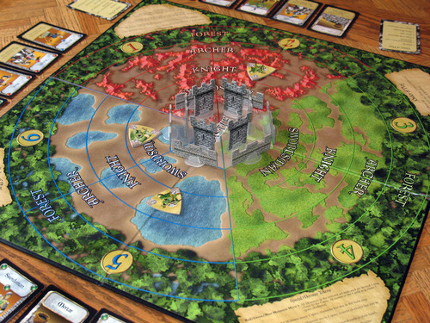
Castle Panic

Slide 4
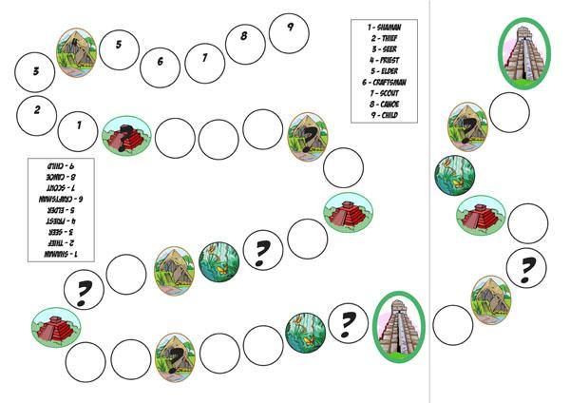
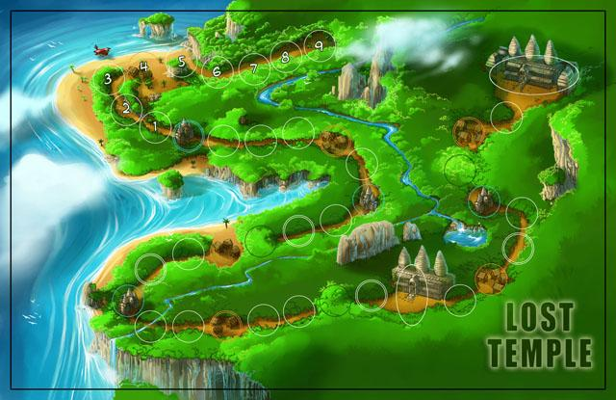
Lost Temple

Slide 5
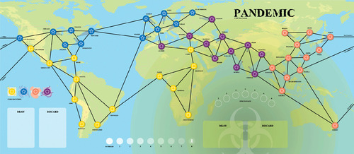
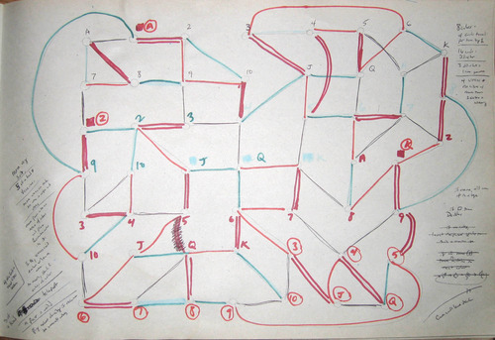
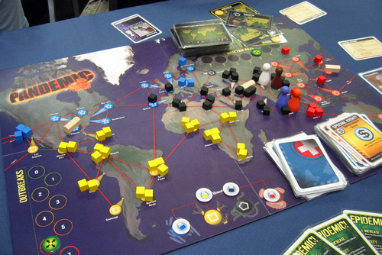
Pandemic

Slide 6
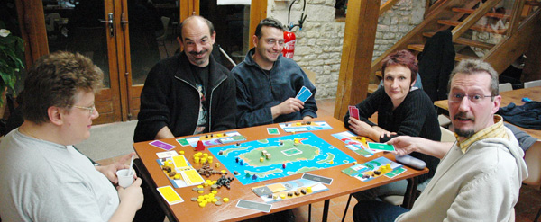
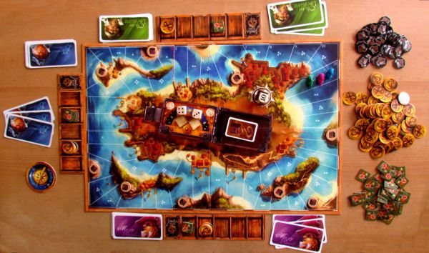
Jamaica

Slide 7
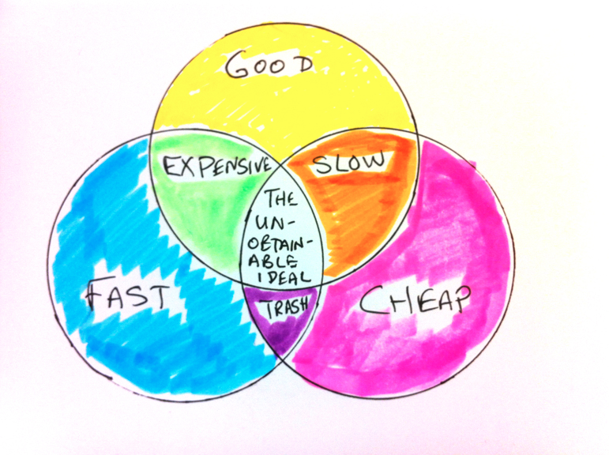
For your initial prototype, which two are most important: good, fast, or cheap?

Slide 8
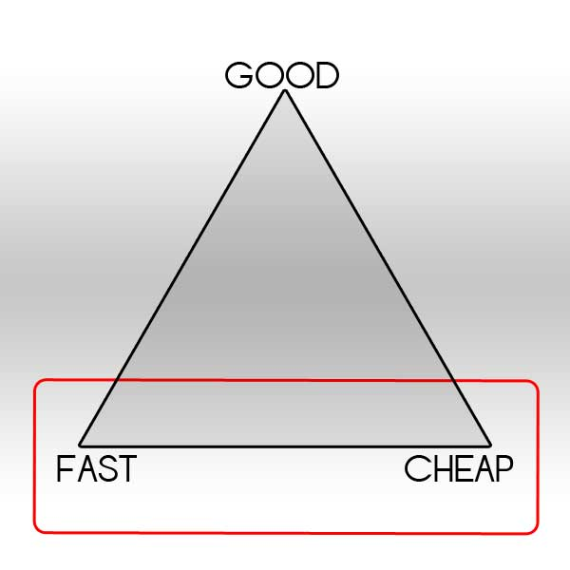
Answer:

Slide 9
Fast & Cheap
Build it as fast as possible. Cut corners. Make it as ugly and cheap as you can get away with.
Minimize what you need to build. Only do what is absolutely necessary to evaluate your game. There is a time and place for making nice-looking components, and the early stages of game design is not that time or that place.
Make your prototype easy to change. You will find problems in playtesting, so make it easy to adjust on the fly.

Slide 10
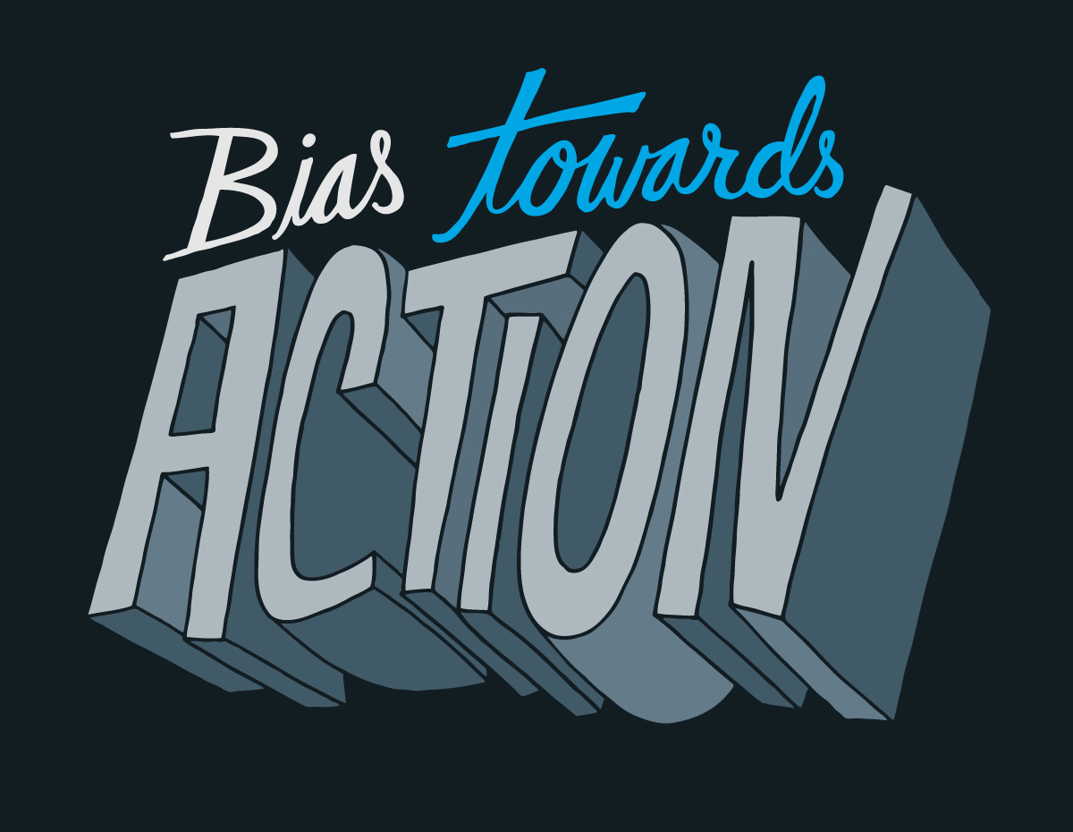

Slide 11
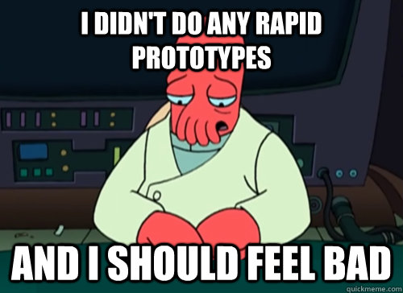
Rapid Prototyping

Slide 12
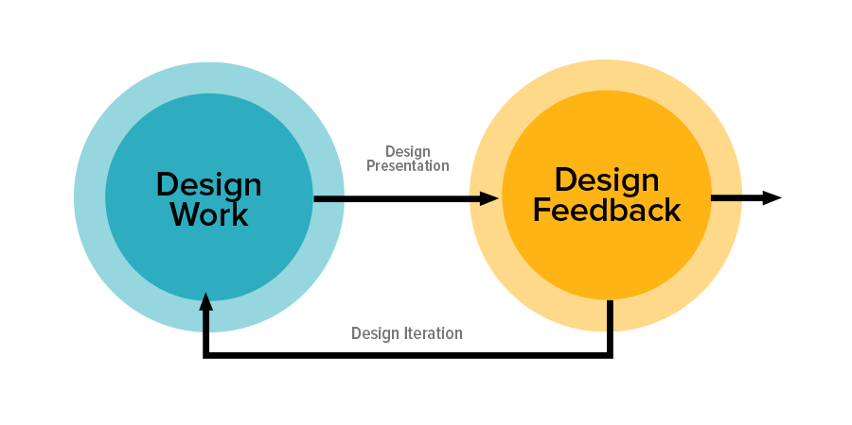
Rapid Prototyping = Iteration
Design risk: the risk that the game won’t be fun & people won’t like it.
Iteration: Iterative design is a design methodology based on a cyclic process of prototyping, testing, analyzing, and refining a product or process. Based on the results of testing the most recent iteration of a design, changes and refinements are made.

Slide 13
Rapid Prototyping = Iteration
The purpose of iteration is to lower design risk.
It’s important to create prototypes quickly to see what’s workable.
The more times you iterate, the better your final game will be and the more you can be certain that the rules of your game are effective.

Slide 14
Ideas to Consider

Slide 15
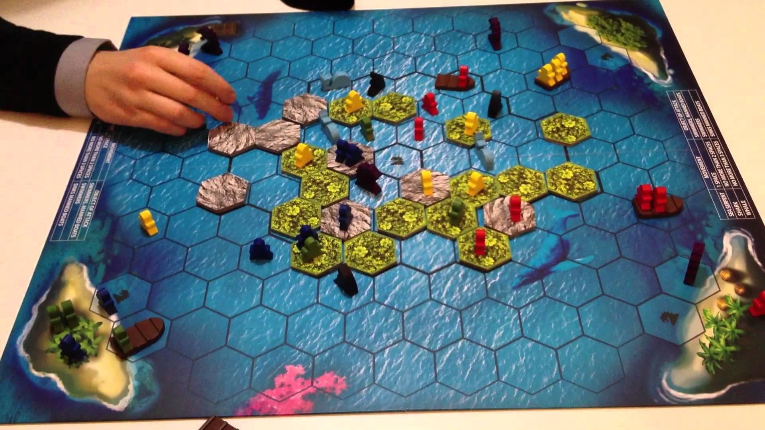
Theme
Themes can range from “pasted on” to fully integrated into the game.
What can you do to make sure the core thematic elements are really present in your game?
What specific parts of your theme must be included to make the theme integrated?
Survive: whales attack boats not people, sharks eat people not boats, sea monsters all of it

Slide 16
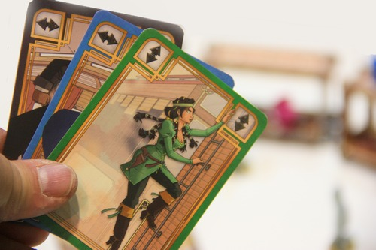
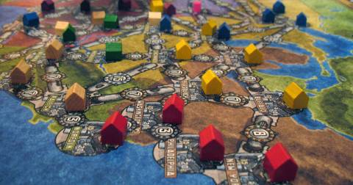
Mechanics
Which mechanics really express the core story of your game?
Match the mechanics to the task.

Slide 17
Iterative Design, Round Two

Slide 18
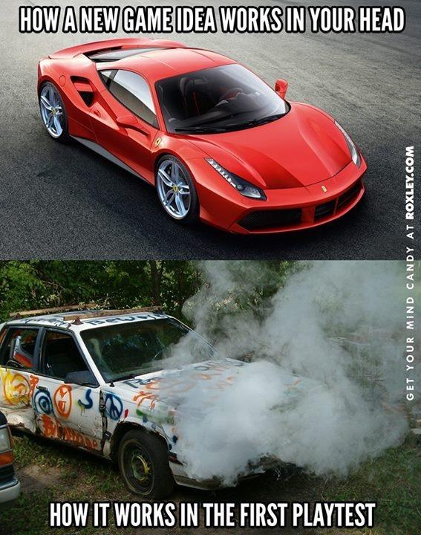

Slide 19
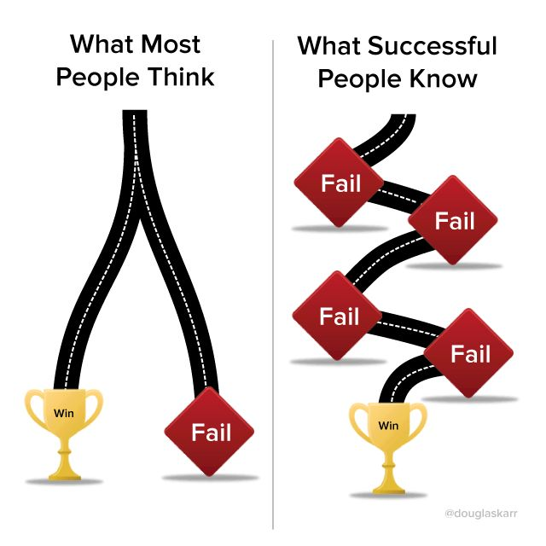

Slide 20
Other Design Considerations

Slide 21
Objectives & Victory Conditions

Slide 22
Gaming Space
How you define the game space—number of regions, hexes, or squares, the different types of spaces available, how those spaces are used—has a significant impact on the game, especially as it evolves.
Good designers make thoughtful choices to the game space and player components.

Slide 23
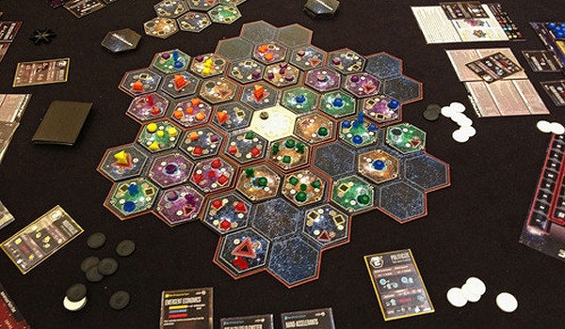
Gaming Space
Fixed game board
Rectangular or square
Square, hexagon, or other
geometric tiling
Organic or irregular forms
Modular board
Start game with a modular setup OR
Build the board as the game develops
No board
Tiles/other bits are laid on the table to create a gaming space.

Slide 24
Information
The game board and all bits’ purposes are to track information.
Most public information: the board
Playing space
information recording space
Track resources, point scored, other public information necessary

Slide 25
Information
The game board and all bits’ purposes are to track information.
Moderately public information: cards
Number of cards
distribution of cards based on content
availability of cards to players
cost of cards
use of cards
whether or not players play cards publicly,
whether or not available cards are public, face down, in a deck, arrayed in matrix or some other fashion

Slide 26
Information
The game board and all bits’ purposes are to track information.
Least public or known information: dice
Dice come 4, 6, 8, 10, 12, and 20 sided
Blank dice can be customized via stickers and markers
Randomness can be an advantage or disadvantage for players

Slide 27
Information, con’t
How to help players track their information?
o Scoring track to publicly share players’ progress
o Scoring coins, chits, or other markers that may or may not be private
o Resources may be tokens, land, natural resources, human resources, and game points.
o Sometimes these resources may be used in the game, other times they are collected towards end game conditions only
Bits, chits, and tokens help players to manage and utilize resources.

Slide 28
Player Positioning
Player Turns
Most games have an initial start player then play proceeds to the left until the end of the game. This may actually create an imbalance, as the player to one’s right has a higher impact on you than other players, and you have a higher impact on the player to your left. Options to control player turn order include:
A variable turn order determined by a specific choice or some other game element so the first-player or clockwise advantage is reduced.
The last-place player becomes start player for the round (see catch-up mechanism)

Slide 29
Player Positioning
Catch-up Mechanism
Inevitably, some players may fall significantly behind other players. A catch-up mechanism is designed to either make victory harder for the winning player OR make it easier for the player or players not in the lead.
The player in last may get to move first, choose resources first, or get another type of advantage, which may be an extra resource.
May be employed at the start of the game to reduce first-player advantage where the first player gets zero resources, the second player gets one, the second gets two, and so on.

